Slide 1





Baltimore City and
Baltimore County
Support, Research, and Facilitation Services
In Association with
Baltimore Regional Water Governance Model Work Group
April 27, 2026

Slide 2


Project Team - Firm Overviews
NewGen Strategies and Solutions | Prime Consultant
Utility-sector management and economic consulting
500+ public utility clients, 1,200+ rate and economic studies
Cost of service, rate design, governance evaluation, and interjurisdictional cost sharing
PEER Consultants | Infrastructure & Operations
Minority-woman-owned engineering and advisory firm
Water/wastewater infrastructure planning, asset management, organizational assessment, and performance benchmarking
Tydings | Legal Analysis
Maryland-based law firm with nearly a century of experience
Enabling legislation, governance authority, interjurisdictional agreements, and cost-sharing mechanisms
Equity-Focused Expertise | Affordability & Equity Analysis
Dr. Manny Teodoro (UW-Madison) and Dr. David Switzer (U of Missouri)
Water equity, affordability policy, rate structure evaluation, and governance responsiveness
Dr. Teodoro and Dr. Switzer
serve as independent advisors

Slide 3
Project Team - Org Chart

Slide 4
Background and Timeline
Business Process Review finalized by NewGen (joint City/County study)
13 Task Force members appointed
Task Force issues final report and recommendations
13 Work Group members announced
Work Group final report
Jul 2021
Jul 2023
Feb 2024
Dec 2025
Dec 2026
Jan-Apr 2023
Sep 2023-Jan 2024
Apr-May 2024
Jan-Oct 2026
HB 843 passed and signed; Task Force created
Task Force holds series of public meetings
HB 1509 passed and signed; Work Group established
Work Group holds series of public meetings
Report
Legislation
Task Force
Work Group

Slide 5
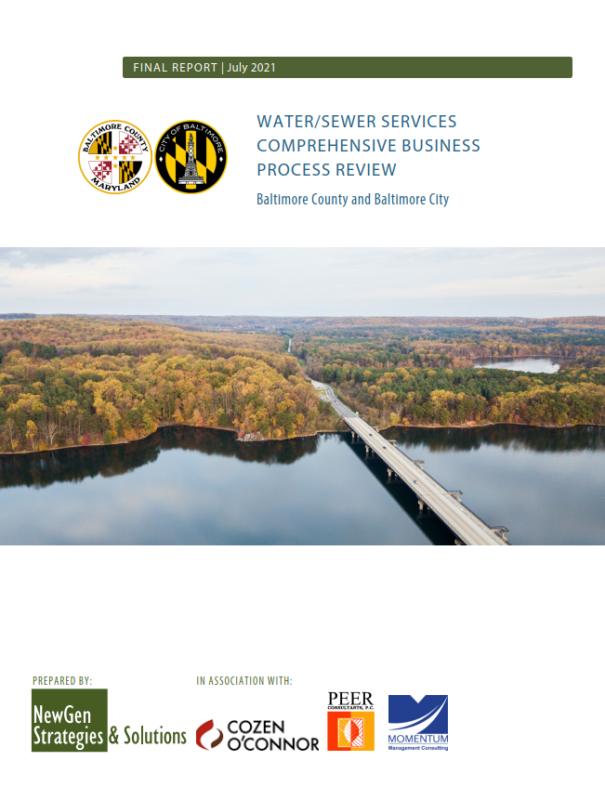
2021 Business Process Review – Task Areas
Task 1 - Evaluate Existing Service Agreements
Task 2 - Review Organizational Structure and Governance
Task 3 - Review
Staffing
Task 4 - Evaluate Planning and Management
Task 5 - Assess
Meter to Cash Operations
Task 6 - Review
Field Operations
Review service agreements (1972 Water and 1974 Sewer intergovernmental agreements, others)
Summarize structure, key terms, cost allocation methodology, key parameters, assumptions
Strengths, constraints, risks and challenges
Review of the existing organizational structure within the City and County and the coordinated City-County governance models
Governance processes and protocols (planning, decision-making, approvals, performance management, hiring)
Review of overall existing levels of staffing in the City and County involved in water and sewer service delivery
Observations on overall skill levels
Identify any skill set gaps
Human capital management processes, succession planning
Capital Programs
Water Loss Management Programs
Drought Response Planning
Safety Programs and Risk Mitigation Planning
Source Water Protection and Land Use Planning
Performance Management
Inter-jurisdiction Communication
IT Systems Review and Disaster Recovery
Sewer Capacity Planning
Metering and Billing Operations
County Water Service Revenue Collection and Annual Reconciliation Process
City-County Data Transfer
Customer Service Performance
County’s Sewer Billing and Meter Applications Permitting
Water Utility Field Operations
Customer Complaints

Slide 6
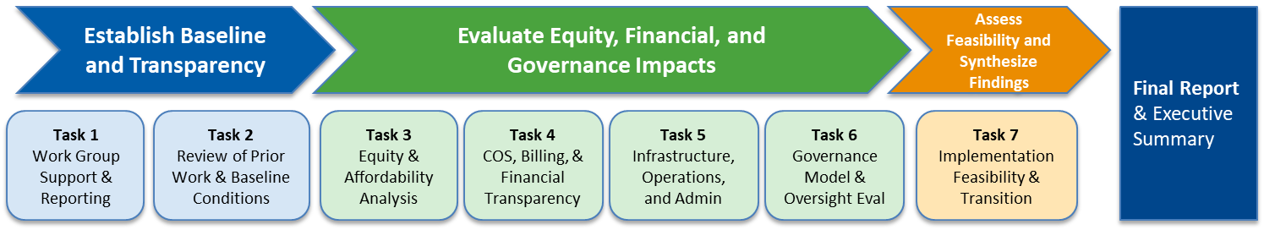
Proposed Workplan and Schedule
Meeting | Date | Location
Work Group Meeting #1 | January 7, 2026 | Baltimore City Hall, City Council Chambers
Work Group Meeting #2 | April 27, 2026 (today) | Jefferson Building, Towson
Work Group Meeting #3 | May 20, 2026 | Baltimore City Hall, City Council Chambers
Work Group Meeting #4 | September 16, 2026 | Jefferson Building, Towson
Work Group Meeting #5 | October 20, 2026 | Baltimore City Hall, City Council Chambers
Milestone | Date
Final Report Completion | December 31, 2026

Slide 7
Committee breakdown
Governance| Chair: Delegate Dana Stein
This committee will focus on the actual structure of a cross-jurisdictional body that will oversee policy for the Baltimore City Water & Wastewater Utility. The focus will be on improving system-wide communication and clarifying workflows. Such a body may also make recommendations for both Baltimore City and Baltimore County.
Delegate Dana Stein, District 11B, Baltimore County
Adam Ortiz, Maryland Department of the Environment
Antoinette Ryan-Johnson, City Union of Baltimore (CUB), Baltimore
Karen Henry, Director of Anne Arundel Department of Public Works
Kelly Baxter, Mid-Atlantic Wastewater Market Sector Lead, HDR
Michael Swygert, Chief, Metropolitan District Financing and Petitions, Baltimore County Department of Public Works and Transportation
Funding & Finance| Chair: Kishia Powell
This committee will evaluate and develop up to date and sustainable approaches to funding agreements with regional partners, and review customer billing structures in both Baltimore City and County.
Senator Mary Washington, District 43, Baltimore City & Baltimore County
Kishia Powell, CEO of WSSC
Comptroller Bill Henry (Chair)
Karen Dettmer, Director of Water Resources US, Ramboll
Matt Carpenter, Deputy Director, Baltimore County Office of Budget & Finance
Matt Garbark, Director of Baltimore City DPW
Pat Moran, AFSCME Council 3

Slide 8
Public Comment

